Slide 1

Peer To Peer Self Driving Car Rental
B.Tech Final External Project Evaluation (CSP 496), VIIIth Sem
Presenters
Zarak Jahan
(2019004410)
Manav Chauhan
(2019640747)
Nazia Parween
(2020002030)
Supervisor
Dr. Megha Chhabra
DEPARTMENT OF COMPUTER SCIENCE & ENGINEERING
SCHOOL OF ENGINEERING & TECHNOLOGY
May, 2023

Slide 2
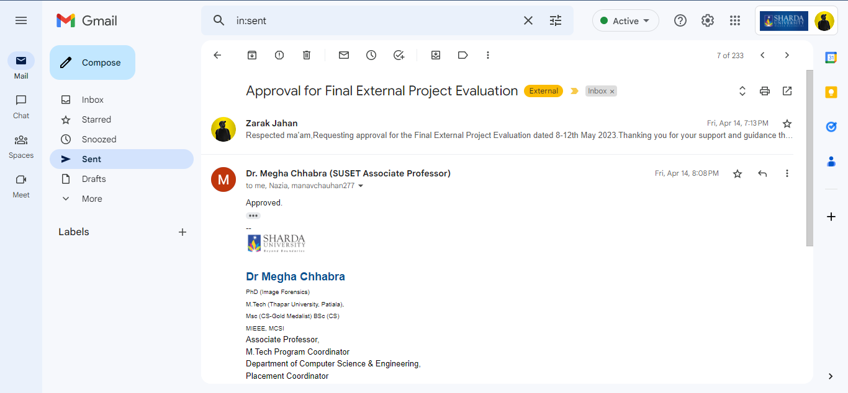
Approval for Final External Project Evaluation VIII SEM

Slide 3
Content
Publications
Introduction
Motivation of the Project
Problem statement
Contribution of the Project
Literature Survey
Constraints Points
Roles and Distribution
Methodology
Platform Architecture
Application Development
Test Cases
VIIth Semester Outcome
VIIIth Semester Outcome
GitHub Link
References

Slide 4
Publications
Sem | Paper Title | Publication
7th Sem | Peer-to-Peer Self-Driving Car Rental: A Case Study on the Development and Limitations of a Novel Transport System. | Published at- Z. Jahan, N. Parween, M. Chauhan and M. Chhabra, "Peer-to-Peer Self-Driving Car Rental: A Case Study on the Development and Limitations of a Novel Transport System," 2023 10th International Conference on Computing for Sustainable Global Development (INDIACom), New Delhi, India, 2023, pp. 5-9.
8th Sem | SERIGO: Development and Implementation of a Peer-to-Peer Self-Driving Car Rental App using Flutter Framework | Published at- Zarak Jahan, Manav Chauhan, Nazia Parween, and Megha Chhabra. SERIGO: Development and Implementation of a Peer-to-Peer Self-Driving Car Rental App using Flutter Framework [J]. Int J Performability Eng, 2023, 19(3): 155-166.
Table 1. Publication Details

Slide 5
Introduction to the Project
The concept of P2P car renting is simple and revolutionary. It allows car owners to make extra money on days when they are not using their car. Just like an Airbnb, the car owner decides the rent of the car, the number of kilometers to be driven and the time period between which one can rent the car.

Slide 6
Motivation of the project
In the consideration with historical and rapid development of car rental companies, the way processes in the companies are taking place today which is quite problematic. The dominating self-driving car rentals companies targets people who don’t want to buy cars or cant afford one thereby neglecting the population who could benefit from their cars when not in use. Thus the motivation of this project is to develop a system to help people with cars to connect with renters directly with no hustle and making a source of income out of it.

Slide 7
Problem Statement
A trusted and secure peer-to-peer car rental system to put the extensively available but still untapped resource of unutilized cars to use.

Slide 8
Contribution
The contributions of this project are:
To find and study the feasibility of the project and propose a hybrid solution i.e. having our own fleet of cars for rent in addition to P2P rentals.
To develop an application for the proposed hybrid solution named as SERIGO.
To provide additional features in the like car services.
To publish one conference paper and one journal paper.

Slide 9
Literature Survey
Authors | Features | Methodology
Ajinkya et al. [2] | Java for android development. Shortest path algorithms for route suggestion. Rider-to-driver communication. Price recommendation using machine learning algorithms. | Developed a ride-sharing programme that enables users to sign up as either drivers or passengers and then locate each other rides within a given location and time frame.
LIU et al. [3] | They addressed the issues of limited capacity and excessive price. They evaluated their suggested approach using a real-world dataset of 65,065 trips. | Developed a ridesharing scheme that made it possible to use the bus service online. For ride-sharing optimization, they created both approximate and accurate algorithms.
Pooyan and Jia [4] | Optimization Algorithm. Employed real-life NYC taxi dataset. | Developed an optimization technique to address the issue of online matching, which determines a passenger's ideal waiting period.
Binu and Viswaraj [5] | Location tracking using Google API. Traffic anomaly detection. For decreasing erroneous anomaly detection, a proposed EM recursive algorithm truth estimation approach was proposed. | Proposed a useful mobile application with special features like traffic anomaly detection and user location monitoring for carpooling.
Bin et al. [6] | Users can specify their maximum pricing range and the maximum amount of time they are ready to wait before getting picked up. Calculates costs according to the trip's distance and any detours are taken. Pruning methods are used by SHAREK to reduce the need for any short-path computations. | Proposed SHAREK, a scalable and effective ride-sharing service that enables users to make a ride request.
Table 2. Related work

Slide 10
Constraints points
The constraints found in this project are :
Willingness of the people –
Attitude of the people towards opting for Peer to peer car sharing scheme.
Knowledge of the business model.
Trust issues, safety concerns and sense of personal belongings not to be shared.
Standard of the market –
Peer to peer car sharing rental companies.
Self-driving rental companies.
Technology used.
Safety measures.
Economy –
Effect of collaborative consumption on the economy.

Slide 11
Roles and distribution
Description | Member Assigned
Requirement analysis. Frontend Development for Car Owner, Buyer and Administrator. | Zarak Jahan And Manav Chauhan
Create and map supply and demand service. Track vehicle and recommendation system. | Manav Chauhan and Nazia Parween
Database creation and management. Literature survey and review writing. | Zarak Jahan and Nazia Parween
Table 3. Workload Distribution

Slide 12
Methodology
We are developing an Android application based on a peer-to-peer collaborative consumption model utilizing Flutter, Android Studio, and Firebase as a result of those solutions and concepts.
Flutter
In May 2017, Google created and released Flutter, a free and open-source mobile UI framework. With only one codebase, you can create a native mobile application. This suggests that you may create two different apps using the same programming language and codebase (for IOS and Android).
Dart
Flutter and dart are both used to create apps. It is an object-oriented language that Google has created. Dart was first created as a JavaScript substitute. With the help of "Generational Waste Accumulation," Dart, a sophisticated programming language, is modified to handle this issue in memory standard.

Slide 13
Methodology
Android Studio
The official Google Integrated Development Environment (IDE) [19] for creating Android applications is called Android Studio. More tools offered by Android Studio increase our ability to create Android apps more quickly.
Firebase
Developers create IOS, Android, and Web apps using the Google-sponsored application development platform known as Firebase. Tools are available from Firebase for monitoring analytics, reporting and resolving app errors, as well as developing marketing and product experiments. The Firebase Database, a cloud-based NoSQL database, synchronizes data across all clients in real-time.

Slide 14
Platform Architecture
The system architecture is based on two main modules: the host module, where users can list their own vehicles for rent, as well as the standard renter module, where users can rent cars.
The process for logging in, posting a vehicle, and finalizing a booking are shown in Figure 1, along with a mathematical explanation of the functional dependence of several objects on each other is provided in Table 4.
The algorithm for the host and renter has also been used to describe the structural layout of the system.

Slide 15
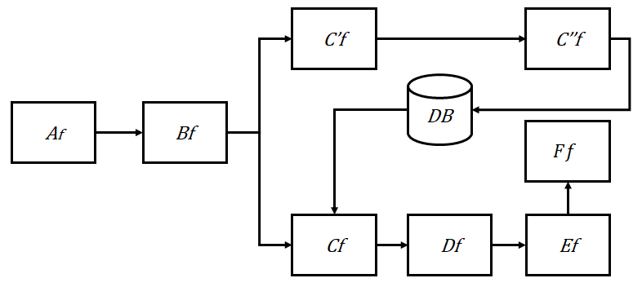

Platform Architecture
$Af$ = Login
$Bf$ = Adding personal information
$Cf$ = Vehicle Listing
$C′f$ = Sign up to Host
$C′′f$ = Enter required vehicle information.
$Df$ = Choosing a car that is on market
$Ef$ = Completing the credentials
$Ff$ = Payment
Figure 1. Functional Dependency Graph

Slide 16
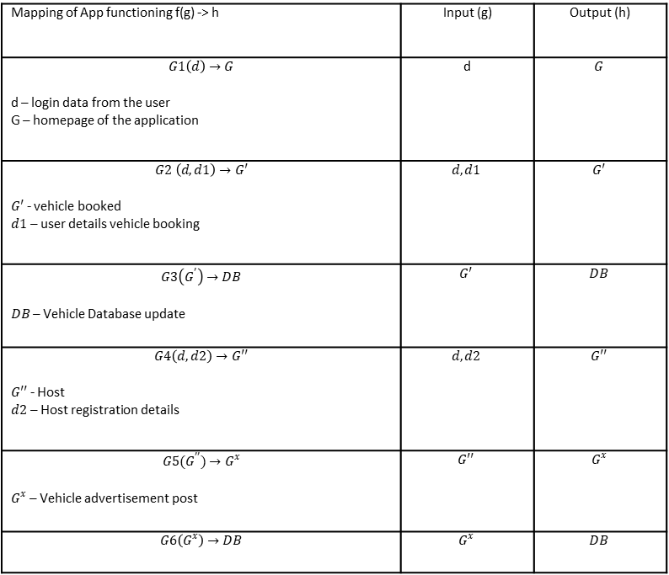

Platform Architecture
Table 4 explains the application's mathematical foundation. Here, $f(g)$stands for the function of g, and to get the required results, we used a variety of functions with a wide range of inputs.
Mapping of App functioning f(g) -> h | Input (g) | Output (h)
$$G1\left(d\right)→G$$ d – login data from the user G – homepage of the application | d | $$G$$
$$G2 \left(d, d1\right)→G′$$ $G′$ - vehicle booked $d1$ – user details vehicle booking | $$d,d1$$ | $$G′$$
$$G3\left(G^{′}\right)→DB$$ $DB$ – Vehicle Database update | $$G′$$ | $$DB$$
$$G4\left(d, d2\right)→G′′$$ $G′′$ - Host $d2$ – Host registration details | $$d, d2$$ | $$G′′$$
$$G5(G^{′′})→G^{x}$$ $G^{x}$ – Vehicle advertisement post | $$G′′$$ | $$G^{x}$$
$$G6\left(G^{x}\right)→DB$$ | $$G^{x}$$ | $$DB$$
Table 4. Mathematical mapping of
Functioning of the project

Slide 17
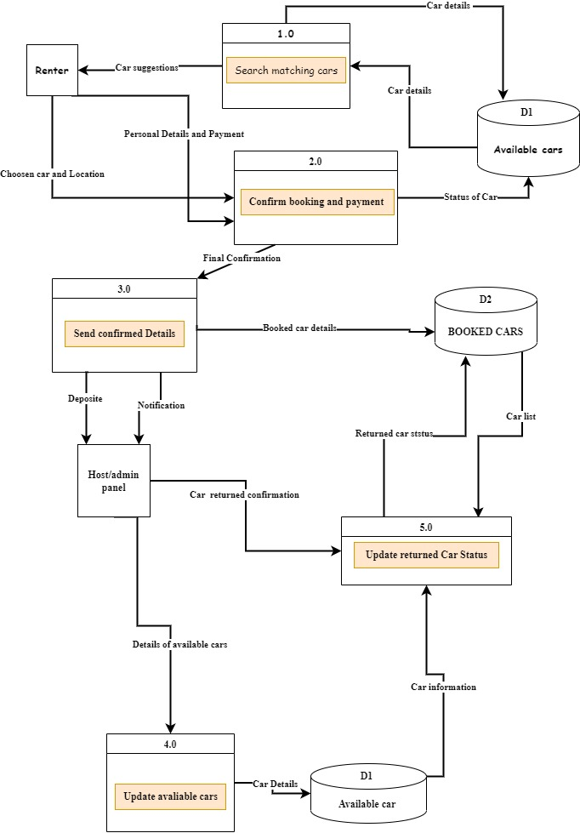
Platform Architecture
In order to prompt discussions about changes and provide a framework to direct software development, Figure 2 explains the structural components of the proposed work in the architectural diagram.
Figure 2. Systematic Architectural Design

Slide 18
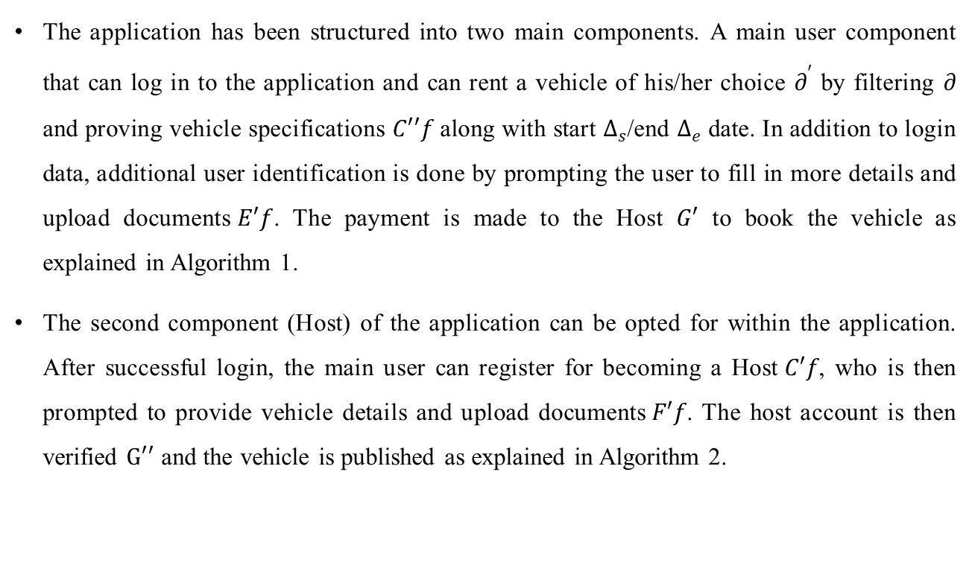
Platform Architecture
The application has been structured into two main components. A main user component that can log in to the application and can rent a vehicle of his/her choice $∂^{′}$ by filtering $∂$ and proving vehicle specifications $C′′f$ along with start $∆_{s}$/end $∆_{e}$ date. In addition to login data, additional user identification is done by prompting the user to fill in more details and upload documents$E′f$. The payment is made to the Host $G′$ to book the vehicle as explained in Algorithm 1.
The second component (Host) of the application can be opted for within the application. After successful login, the main user can register for becoming a Host$C′f$, who is then prompted to provide vehicle details and upload documents$F′f$. The host account is then verified $G′′$ and the vehicle is published as explained in Algorithm 2.

Slide 19
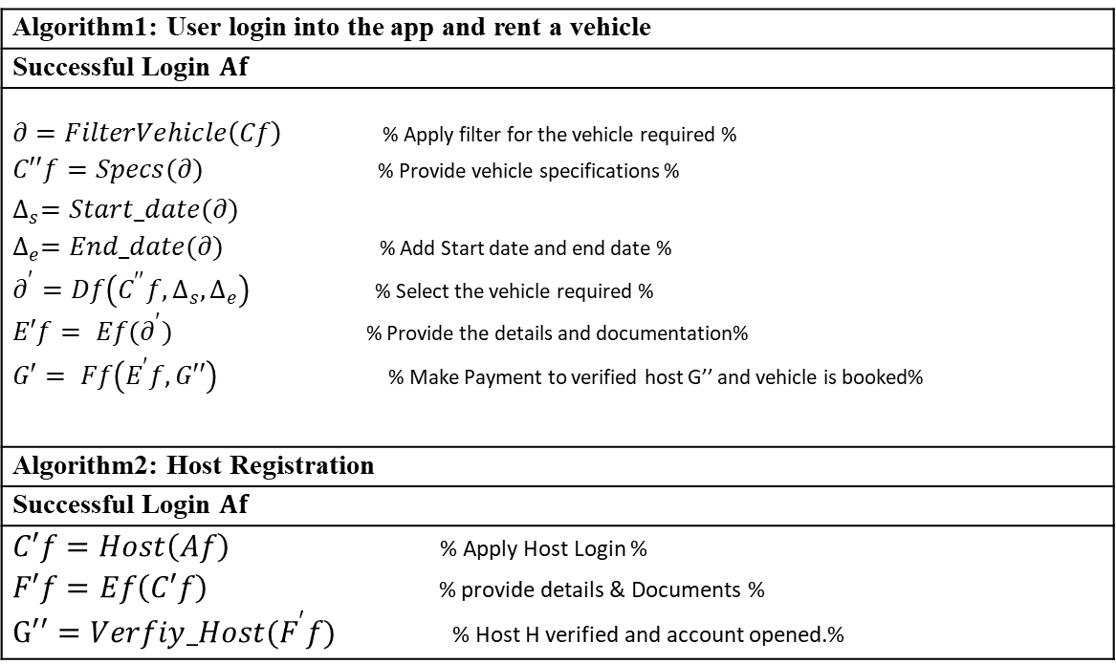
Platform Architecture
Algorithm1: User login into the app and rent a vehicle
Successful Login $Af$
$∂=FilterVehicle\left(Cf\right)$ % Apply filter for the vehicle required % $C′′f=Specs(∂)$ % Provide vehicle specifications % $$∆_{s}={Start_date(∂)}^{}$$ $∆_{e}=End_date(∂)$ % Add Start date and end date % $∂^{′}=Df\left(C^{′′}f,∆_{s},∆_{e}\right)$ % Select the vehicle required % $E′f= Ef(∂^{′})$ % Provide the details and documentation% $G′= Ff\left(E^{′}f,G′′\right)$ % Make Payment to verified host G’’ and vehicle is booked%
Algorithm2: Host Registration
Successful Login $Af$
$C′f=Host\left(Af\right)$ % Apply Host Login % $F′f=Ef\left(C′f\right)$ % provide details & Documents % $G′′=Verfiy_Host(F^{′}f)$ % Host H verified and account opened.%

Slide 20
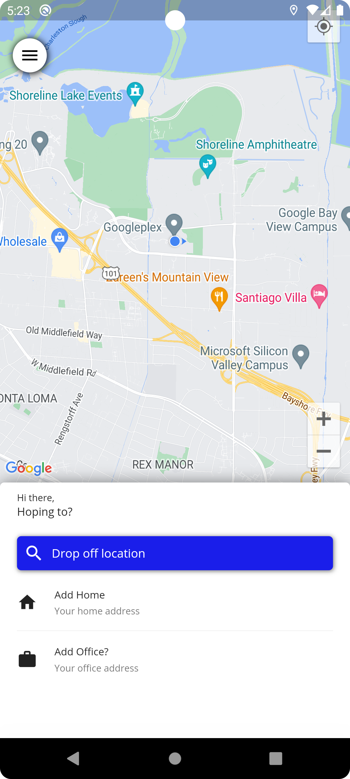
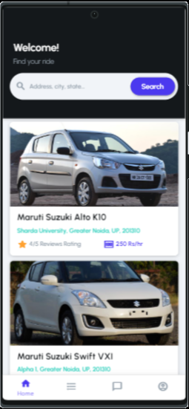
Application Development
Snapshot of application module
Figure 3: Screenshots from APP

Slide 21
Test Cases
Few test cases for the application testing.
Test Case Number | 01
Description of Test Case | Run the main code file on VS code.
Procedure | Debugging and compiling the code. Run the code
Expected outcome | The application should open successfully.
Resultant outcome | The application opens successfully.
Status | Test Case Pass
Test Case Number | 03
Description of Test Case | Vehicle Booking.
Procedure | Select the vehicle of choice. Booking.
Expected outcome | The user should be able to book the vehicle.
Resultant outcome | The booking module responded as expected.
Status | Test Case Pass.
Table 7. Test Case for vehicle booking
Table 5. Test Case for running the code
Test Case Number | 04
Description of Test Case | Vehicle posting.
Procedure | Upload the required details and documents.
Expected outcome | The Host should be able to post their vehicle.
Resultant outcome | The vehicle is posted for rent and is visible on the homepage.
Status | Test Case Pass.
Test Case Number | 02
Description of Test Case | The registration page should open and take input.
Procedure | Enter email Enter password
Expected outcome | The user should be able to login
Resultant outcome | The user successfully logs in.
Status | Test Case Pass
Table 6. Test Case for registration
Table 8. Test case for vehicle posting

Slide 22
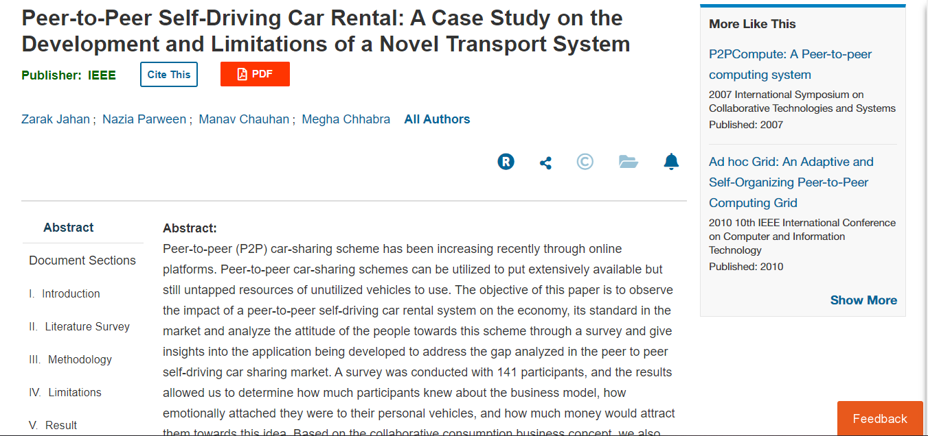
VIIth Semester Outcome
Conference: Published
Z. Jahan, N. Parween, M. Chauhan and M. Chhabra, "Peer-to-Peer Self-Driving Car Rental: A Case Study on the Development and Limitations of a Novel Transport System," 2023 10th International Conference on Computing for Sustainable Global Development (INDIACom), New Delhi, India, 2023, pp. 5-9.
URL: https://ieeexplore.ieee.org/document/10112328
Figure 4: Conference Paper Page

Slide 23
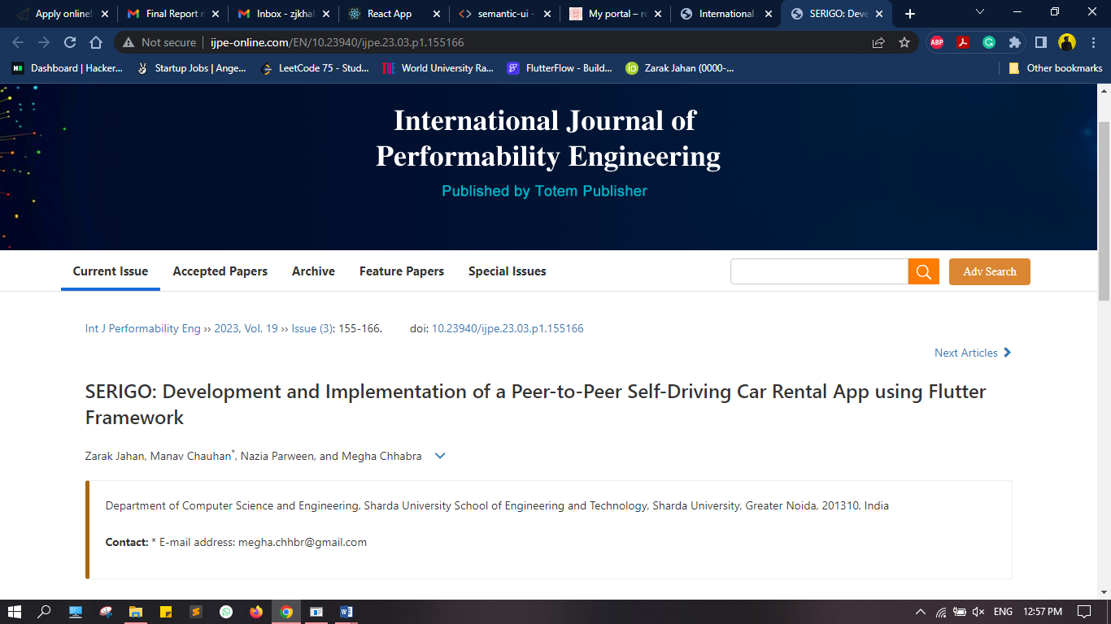
VIIIth Semester Outcome
Journal: Published
Zarak Jahan, Manav Chauhan, Nazia Parween, and Megha Chhabra. SERIGO: Development and Implementation of a Peer-to-Peer Self-Driving Car Rental App using Flutter Framework [J]. Int J Performability Eng, 2023, 19(3): 155-166.
doi: 10.23940/ijpe.23.03.p1.155166
URL: http://www.ijpe-online.com/EN/10.23940/ijpe.23.03.p1.155166
Figure 5: Journal Paper page

Slide 24
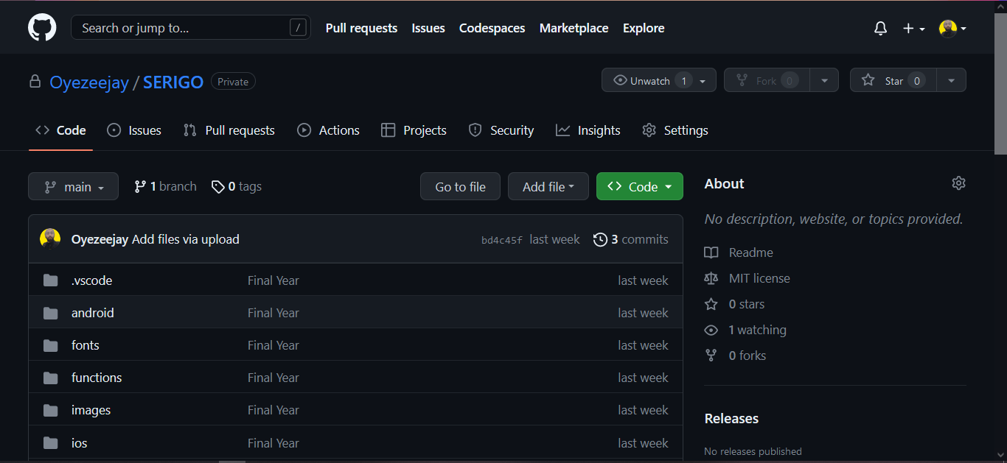
GitHub
GitHub Link
https://github.com/Oyezeejay/SERIGO
Figure 6: GitHub Page

Slide 25
References
E. Ferguson, “The rise and fall of the American carpool: 19701990,’’ Transportation,” vol. 24, pp. 349–376, 1997.
A. Ghorpade, A. Joshi, S. Mali, P. Agrawal, and H. Agrawal, “Pool: A peer-to-peer ride sharing app,” International Journal of Engineering Applied Sciences and Technology, vol. 5, no. 12, 2021.
K. Liu, J. Zhang, and Q. Yang, “Bus Pooling: A Large-Scale Bus Ridesharing Service,” IEEE Access, vol. 7, pp. 74248–74262, 2019.
P. Ehsani and J. Y. Yu, “The merits of sharing a ride,” in 2017 55th Annual Allerton Conference on Communication, Control, and Computing (Allerton), 2017.
P. K. Binu and V. S. Viswaraj, “Android-based application for efficient carpooling with user tracking facility,” in 2016 IEEE International Conference on Computational Intelligence and Computing Research (ICCIC), 2016.
B. Cao, L. Alarabi, M. F. Mokbel, and A. Basalamah, “SHAREK: A scalable dynamic ride-sharing system,” in 2015 16th IEEE International Conference on Mobile Data Management, 2015.
D. Dimitrijevic, V. Dimitrieski, and N. Nedic, Real-time carpooling and ride-sharing: Position paper on design concepts, distribution and cloud computing strategies Computer Science. 2013.
“Apache Cordova,” Apache.org. [Online]. Available: https://cordova.apache.org. [Accessed: 27-Dec-2022].

Slide 26
References
X. Duan, C. Jin, X. Wang, A. Zhou, and K. Yue, “Real-Time Personalized Taxi-Sharing,” in Database Systems for Advanced Applications, Cham: Springer International Publishing, 2016, pp. 451–465.
C. Gedam, M. Sahare, R. Sachdeo, and N. Kulkarni, “Smart transportation based car pooling system,” E3S Web Conf., vol. 170, p. 03004, 2020.
R. Hasan, A. H. Bhatti, M. S. Hayat, H. M. Gebreyohannes, S. I. Ali, and A. J. Syed, “Smart peer carpooling system,” in 2016 3rd MEC International Conference on Big Data and Smart City (ICBDSC), 2016.
B. Shen, Y. Huang, and Y. Zhao, “Dynamic ridesharing,” SIGSPATIAL Spec., vol. 7, no. 3, pp. 3–10, 2016.
S. Ma, Y. Zheng, and O. Wolfson, “T-share: A large-scale dynamic taxi ridesharing service,” in 2013 IEEE 29th International Conference on Data Engineering (ICDE), 2013.
X. Xing, T. Warden, T. Nicolai, and O. Herzog, “SMIZE: A spontaneous ride-sharing system for individual urban transit,” in Multiagent System Technologies, Berlin, Heidelberg: Springer Berlin Heidelberg, 2009, pp. 165–176.
V. Armant and K. N. Brown, “Minimizing the driving distance in ride sharing systems,” in 2014 IEEE 26th International Conference on Tools with Artificial Intelligence, 2014.
J. Gaur, A. Goyal, T. Choudhury, and S. Sabitha, “A walk through of software testing techniques,” in 2016 International Conference System Modeling & Advancement in Research Trends (SMART), 2016.

Slide 27


